Slide 1
Jermyn Borough Council Meeting
01/02/2024

Slide 2
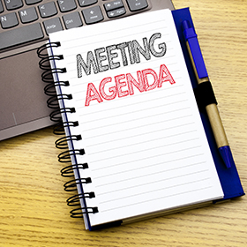
Meeting Agenda
JANUARY 2, 2024
SWEARING IN OF COUNCIL MEMBERS(MAYOR)
CALL TO ORDER(MAYOR)
PLEDGE OF ALLEGIANCE
ROLLS CALL
NOMINATIONS AND ELECTION FOR COUNCIL PRESIDENT (DO NOT REQUIRE A SECOND AND VOTE WILL BE IN ORDER OF NOMINATIONS UNTIL A MAJORITY ELECTS A PRESIDENT
MAYOR TURNS THE GAVEL OVER TO THE PRESIDENT
NOMINATIONS/ELECTION OF VICE PRESIDENT AND PRESIDENT PRO TEM
APPOINTMENT OF VACANCY BOARD CHAIR (CURRENTLY CINDY STEPHENS)
COMMITTEE ASSIGNMENTS (PRESIDENT APPOINTS /CAN BE PUT OFF UNTIL FEB MEETING)
REVIEW OF COMMISIONS/ADVISORY BOARDS
SOLICITOR APPOINTMENT (CURRENTLY LAW FIRM OF LARRY MORAN JR)
ZONING OFFICER APPOINTMENT (CURRENTLY BOB CHASE)
FIRE CHIEF APPOINTMENT (CURRENTLY STANLEY HOLLOWICH)
POLICE CHIEF APPOINTMENT (CURRENTLY BILL ARTHUR)
APPOINTMENT OF ENGINEERING FIRM (CURRENTLY KBA)
APPOINTMENT OF SECRETARY/TREASURER (CURRENTLY SHANNON LEE)
APPOINTMENT OF BUILDING CODE INSPECTION FIRM (CURRENTLY NEIC)
APPOINTMENT OF EMA DIRECTOR (CURRENTLY JIM PERRY)
START OF REGULAR JANUARY MEETING
ROLL CALL
CORRESPONDENCE
PREVIOUS MEETING MINUTES
BILLS PAYABLE/TREASURER REPORT
PUBLIC COMMENT
PROFESSIONAL REPORTS
COMMITTEE REPORTS
NEW BUSINESS

Slide 3
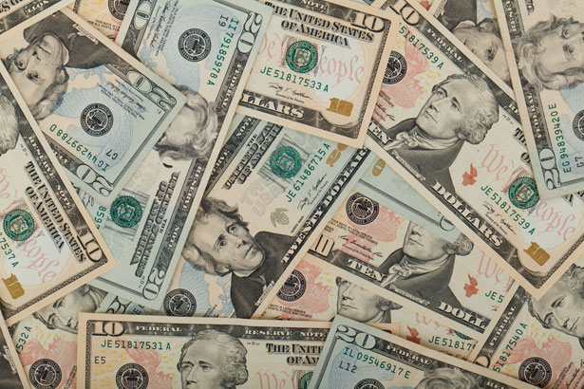
Treasurer’s report
1/2/2024
ASSETS
Checking/Savings
American Rescue Plan Fund 135,737.20
Capital Reserve - DPW 729.48
Capital Reserve - Police 5,369.82
Crime Watch Fund 222.69
General Fund - Community 62,914.58
General Fund - FNB 6,793.81
Holiday Lights Fund 1,459.0

Slide 4
Treasurer’s report
Investment - General Fund 1,059.54
Investment - Liquid Fuels 23,329.00
Investment - Paving Fund 1,070.57
Investment - Recycling 117.02
Investment - Refuse 166.86
Liquid Fuels - FNB 10,460.49
Petty Cash 223.00
Recreations Fund 28,222.27
Recycling - Community 3,364.59
Refuse Checking - FNB 61,274.01
Total Checking/Savings 342,514.02

Slide 5
Treasurer’s report
200000 · Accounts Payable 44,826.20
Long Term Debt 160,122.30

Slide 6


